Slide 1
Advocacy case study: Advancing HIV justice, resisting HIV criminalization
Edwin J Bernard, Global Co-ordinator
HIV Justice Network / HIV JUSTICE WORLDWIDE

Slide 2
Conflict of interest statement
None

Slide 3
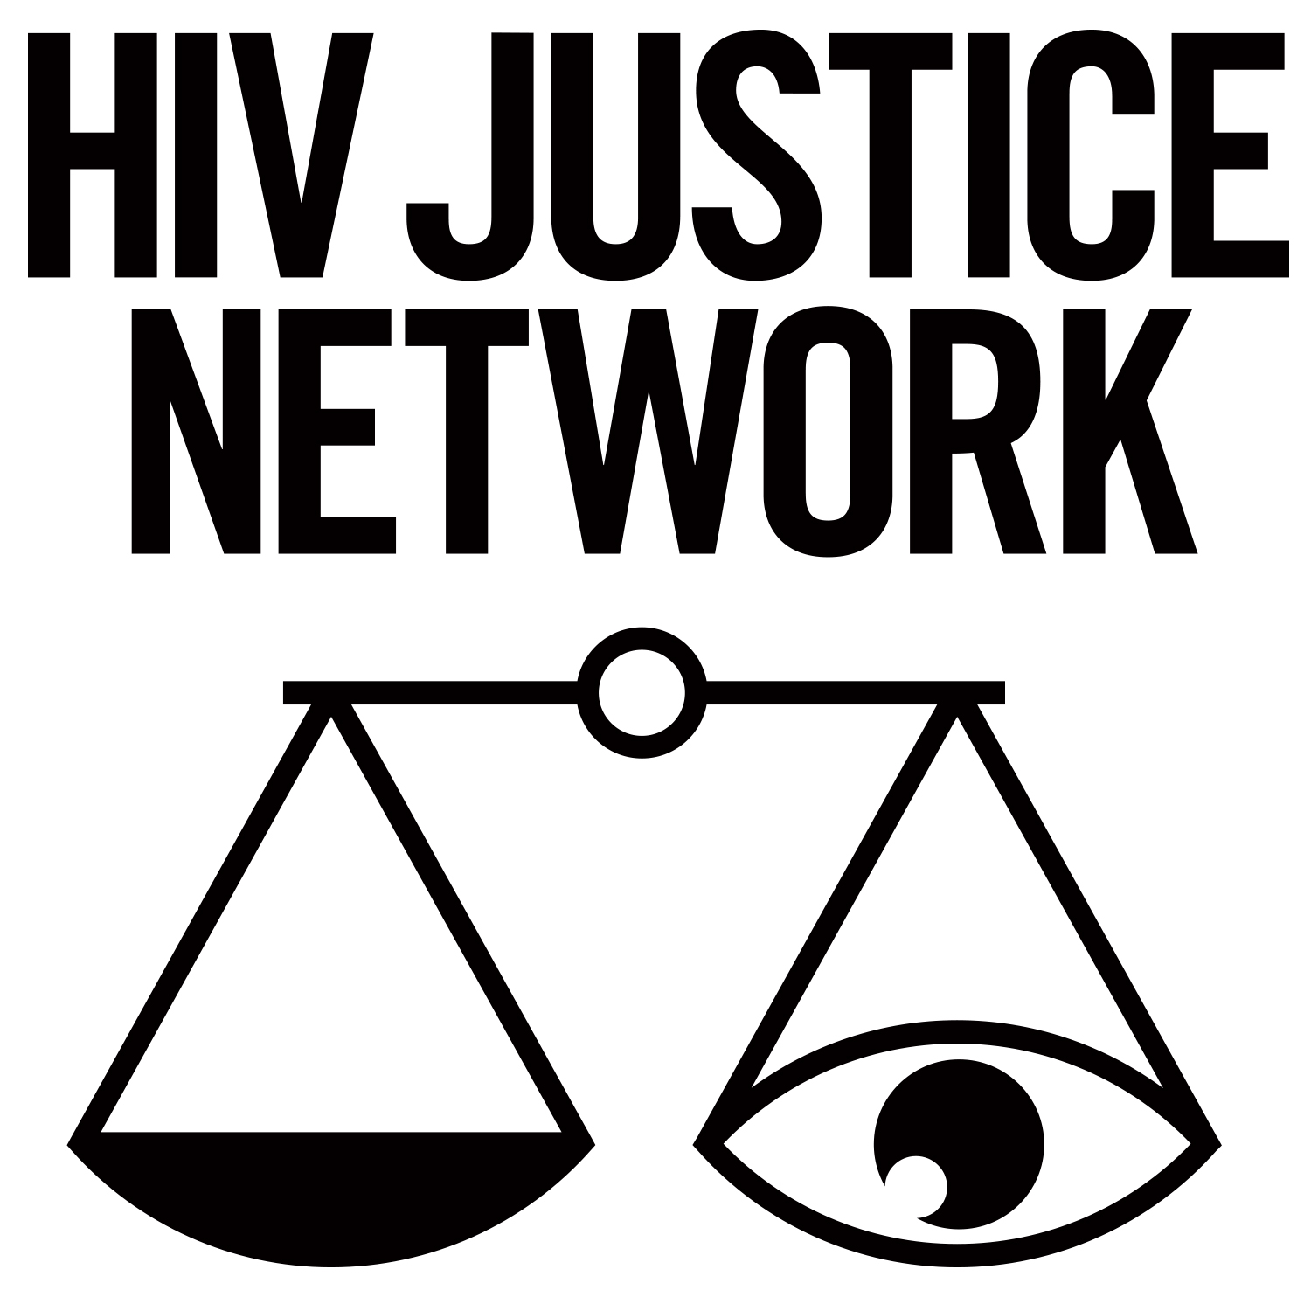
“In much of the world it is a crime to expose another person to HIV or to transmit it, especially through sex. Fundamentally unjust, morally harmful, and virtually impossible to enforce with any semblance of fairness, such laws impose regimes of surveillance and punishment on sexually active people living with HIV, not only in their intimate relations and reproductive and maternal lives, but also in their attempts to earn a living.”
HIV and the Law: Rights, Risks and Health, July 2012
www.hivlawcommission.org
Notes:
In much of the world it is a crime to expose another person to HIV or to transmit it, especially through sex. Fundamentally unjust, morally harmful, and virtually impossible to enforce with any semblance of fairness, such laws impose regimes of surveillance and punishment on sexually active people living with HIV, not only in their intimate relations and reproductive and maternal lives, but also in their attempts to earn a living.

Slide 4
What is the impact of ‘HIV criminalisation’?
Overly-broad HIV-specific criminal laws and/or unjust application of general criminal or similar laws to people living with HIV based solely on HIV-positive status
Growing global phenomenon
Increasingly recognised as an important public health and human rights issue
Selective and arbitrary prosecutions
Disproportionate impact on women and key populations
Can be used for threats, abuse and retaliation
Improper and insensitive police investigations
Limited access to competent defence lawyers
Disproportionate sentencing
Stigmatising media reporting
A barrier to HIV prevention, treatment and care
Notes:
HIV criminalisation describes the unjust application of the criminal law to people living with HIV based solely on their HIV status – either via HIV-specific criminal statutes, or by applying general criminal laws/
HIV criminalisation is a growing global phenomenon that until recently hasn’t been given the attention it deserves considering the impact it has on the HIV response, undermining Fast Track goals to end the AIDS epidemic by 2030.
There is a growing body of evidence that HIV criminalisation is also having a negative impact on the human rights of people living with HIV, often also members of key populations due to:
selective and/or arbitrary investigations/prosecutions
the use of threats of allegations triggering prosecution as a means of abuse or retaliation against a current or former partner living with HIV;
improper and insensitive police investigations;
limited access to justice, including as a result of inadequately informed and competent legal representation;
sentencing and penalties that are often vastly disproportionate to any potential or realised harm;
stigmatising media reporting, including names, addresses and photographs of people with HIV, including those not yet found guilty of any crime but merely subject to allegations.

Slide 6
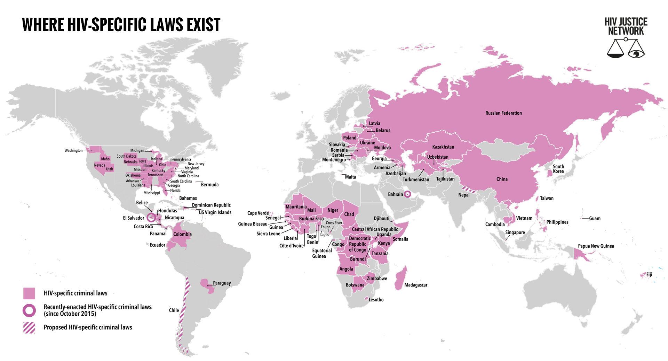
Data correct as of 1st July 2018
Source: Bernard EJ and Cameron S. Global trends in HIV criminalisation: Overview, analysis and country ranking. TUPED512
Notes:
A total of 100 jurisdictions in 73 countries currently have HIV-specific criminal laws. During the audit period, two new HIV-specific criminal laws were enacted (in Bahrain and El Salvador) and two HIV-specific criminal laws remain proposed (in Chile and Nepal)

Slide 7
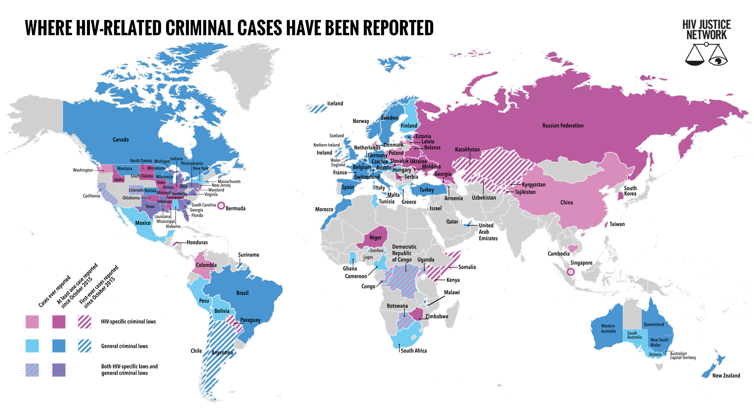
Data correct as of 1st July 2018
Source: Bernard EJ and Cameron S. Global trends in HIV criminalisation: Overview, analysis and country ranking. TUPED512
Notes:
At least 115 jurisdictions in 76 countries have ever applied HIV-specific or general laws (or both) to prosecute people with HIV for alleged HIV non-disclosure, potential or perceived exposure or non-intentional transmission.
During the audit period, nine jurisdictions applied their HIV-specific criminal laws for the first time: Honduras, Kenya, Kazakhstan, Kyrgyzstan, Nigeria (Lagos State), Paraguay, Somalia, Tajikistan and Uzbekistan.
Cases were reported for the first time in a further nine jurisdictions that applied general criminal laws: Chile, Iceland, Ireland, Israel, Malawi, Nigeria (Zamfara state), Suriname and United Kingdom (Northern Ireland).
The majority of reported cases occurred in the US (143), Belarus (128), Russia (126), Ukraine (29), Canada (22) and Zimbabwe (15), with high numbers of cases reported in the US states of Florida (26), Ohio (18) and Tennessee (18).
Belarus (8.5 per 1000) and the Czech Republic (3.3 per 1000) had the greatest number of per capita cases during the audit period.

Slide 8
What is ‘HIV criminalisation’?
Too many people living with HIV are being convicted of ‘crimes’ contrary to international guidelines on HIV and human rights as well as contrary to scientific evidence, medical evidence and best public health advice.
Notes:
Best available scientific and medical evidence should guide any use of criminal law

Slide 9
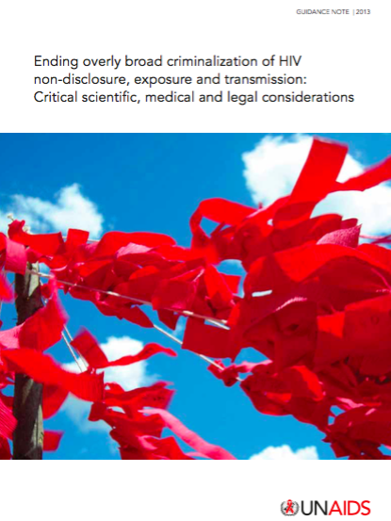
UNAIDS Recommendations
Restrict the use, if any, of criminal law in the context of HIV, ideally to intentional transmission only.
Where it is used, criminal justice principles (including key criminal law principles of legality, foreseeability, intent, causality, proportionality and proof) should be upheld.
Best available scientific and medical evidence should guide any use of criminal law.
Treat like harms alike, with proportionate penalties.
Condoms or low viral load = no significant risk; shows no intent to harm.
Non-disclosure alone is not proof of malicious intent.
Limitations of scientific tests for use in HIV forensics (e.g. phylogenetic analysis).

Slide 10
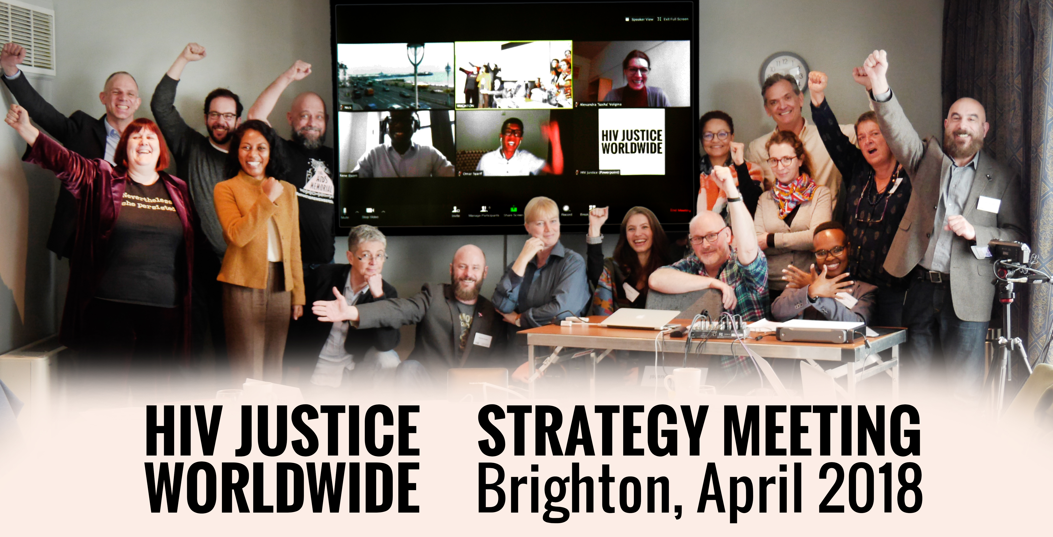
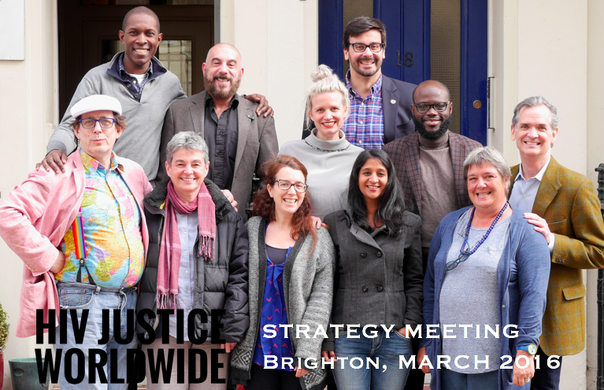
Growing the global movement

Slide 11
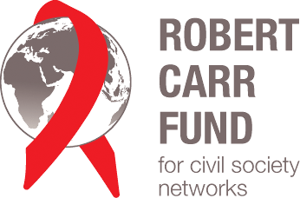
STEERING COMMITTEE
AIDS Action Europe
AIDS-Free World
AIDS and Rights Alliance for Southern Africa (ARASA)
Canadian HIV/AIDS Legal Network
Global Network of People Living with HIV (GNP+)
HIV Justice Network
International Community of Women Living with HIV (ICW)
Positive Women's Network - USA (PWN-USA)
Sero Project (SERO)
Southern Africa Litigation Centre (SALC)
Supported by

Slide 12
HIV JUSTICE Toolkit
http://toolkit.hivjusticeworldwide.org

Slide 13
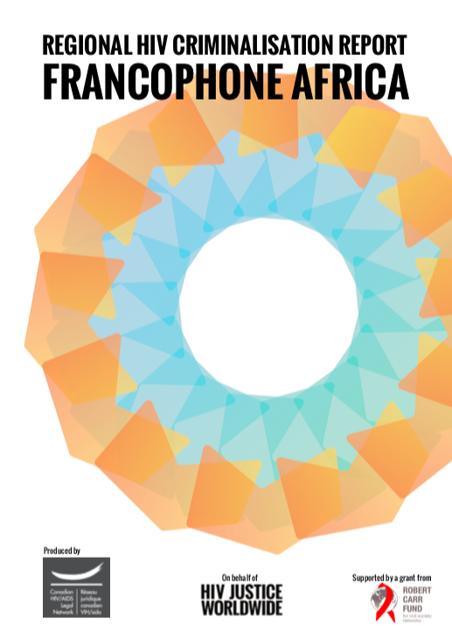
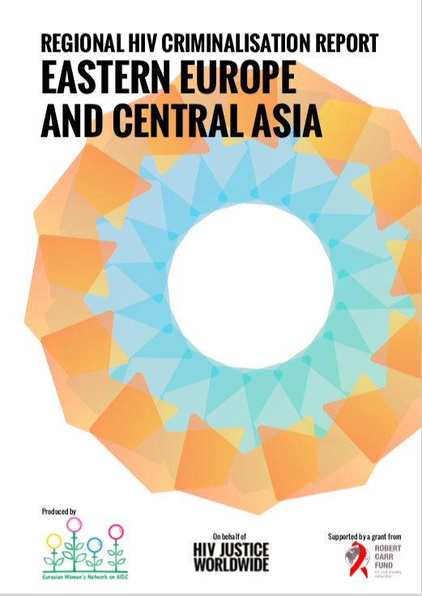
Regional Reports / Regional Hubs
www.hivjusticeworldwide.org/en/milestones

Slide 14
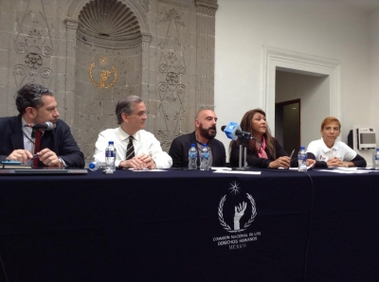
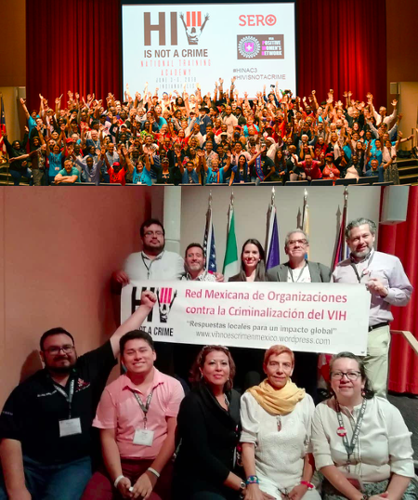
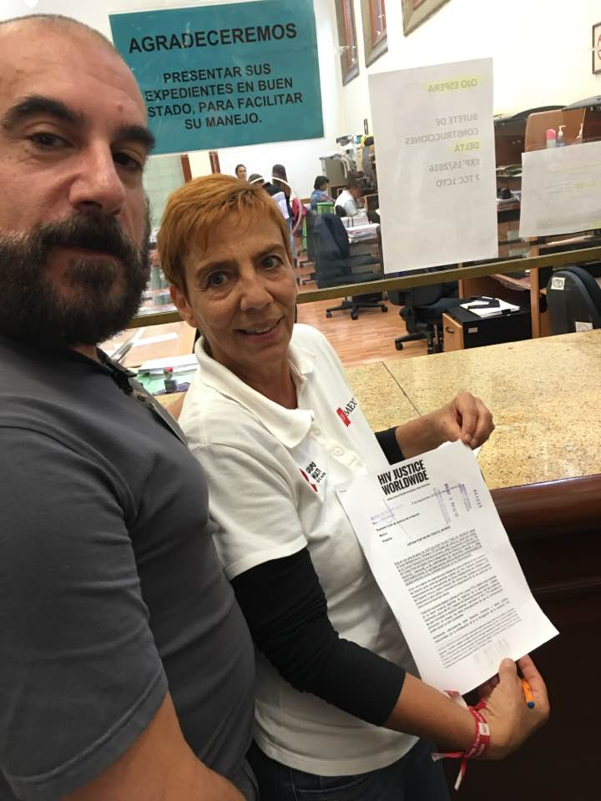
Advancing HIV justice from Mexico…

Slide 15
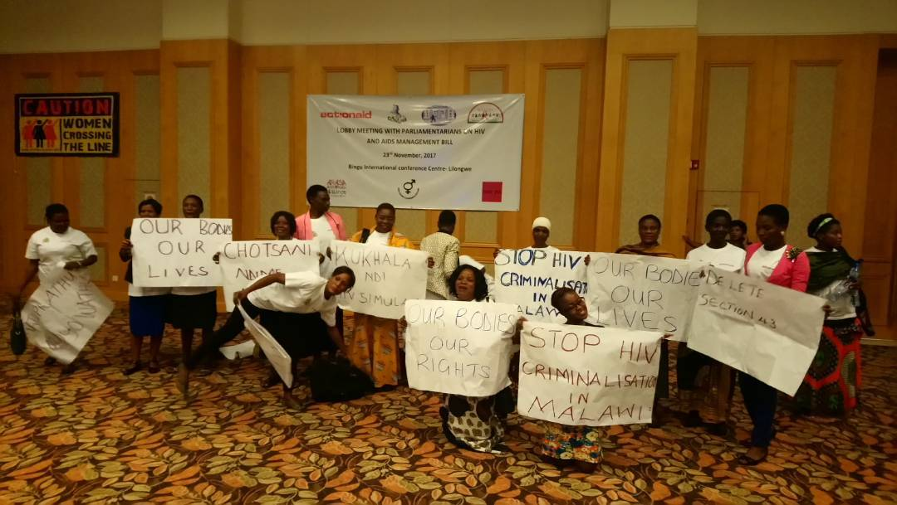
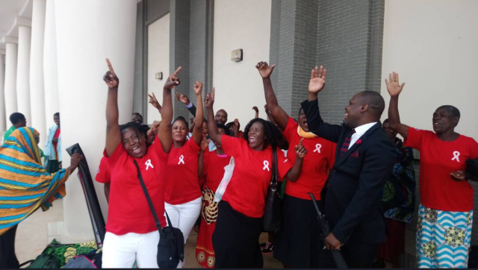
…to Malawi

Slide 16
Global panel of leading scientists
Supported by IAPAC, IAS and UNAIDS
In consultation with HIV JUSTICE WORLDWIDE
A key reference for clarifying important issues of HIV science in the context of criminal law
Aimed at expert witnesses, but helpful for police, prosecutors, lawyers, judges, lawmakers and advocates
To be published on Wednesday 25 July 2018 at 3.15pm in the Journal of the International AIDS Society (JIAS).

Slide 17
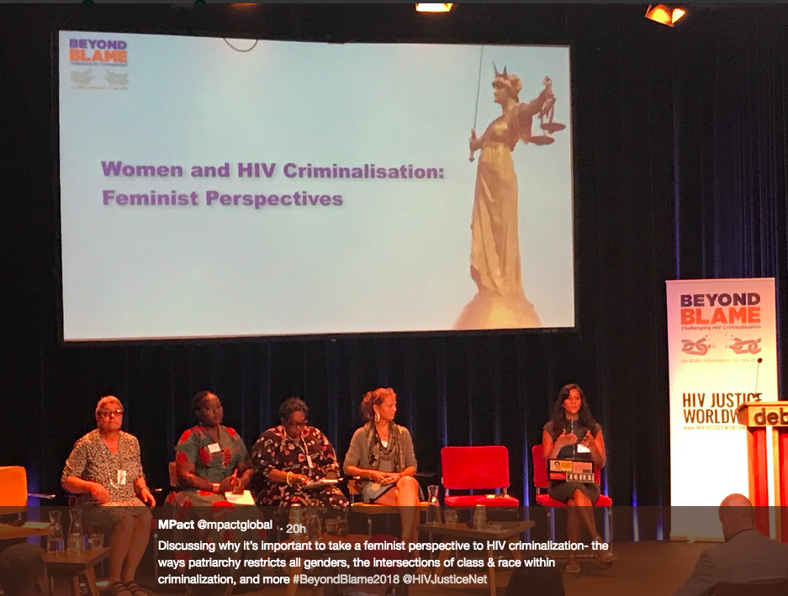
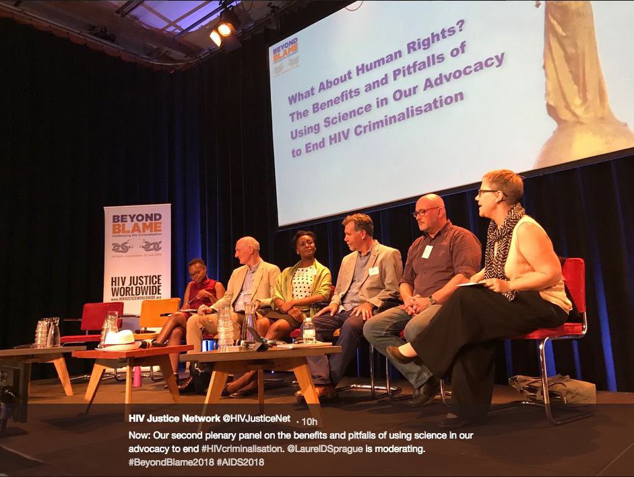
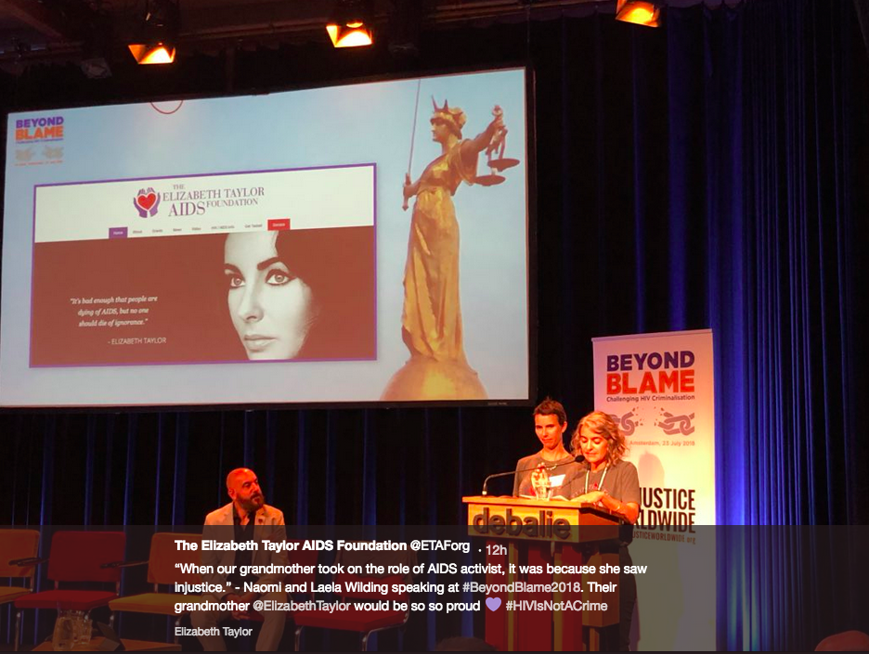
Building an intersectional movement

Slide 18
A (Not So) Simple Equation
HUMAN RIGHTS
SCIENCE
COMMUNITIES
INTERSECTIONALITY
CO-ORDINATION
FUNDING
Notes:
Human Rights + Science + Communities + Intersectionality + Funding + Co-ordination = HIV Justice

Slide 19
A (Not So) Simple Equation
www.hivjusticeworldwide.org
Notes:
Human Rights + Science + Communities + Intersectionality + Funding + Co-ordination = HIV Justice

